Slide 1

Slide 1
PROJECT 261
WORLD DEVELOPMENT MEASUREMENT

Slide 2
Group Members
AMRUTA BORDE
MOHAMMED ALTAMASH
R.RISHITA
MAHESHWARI
RAKESH

Slide 3
Slide 2
Outline:
Introduction to the WDM data set
Exploration of Data
Insights from the Data
Visualization
Model Building and Evaluation
Model Deployment
2

Slide 4
Slide 3
Introduction
Problem statement:
"Empowering global progress through comprehensive data analysis and measurement, driving sustainable development and informed decision-making and effective strategies for a better world."
3
Notes:
Objective: The project’s main aim is to perform clustering to summarise customer segmentation.

Slide 5
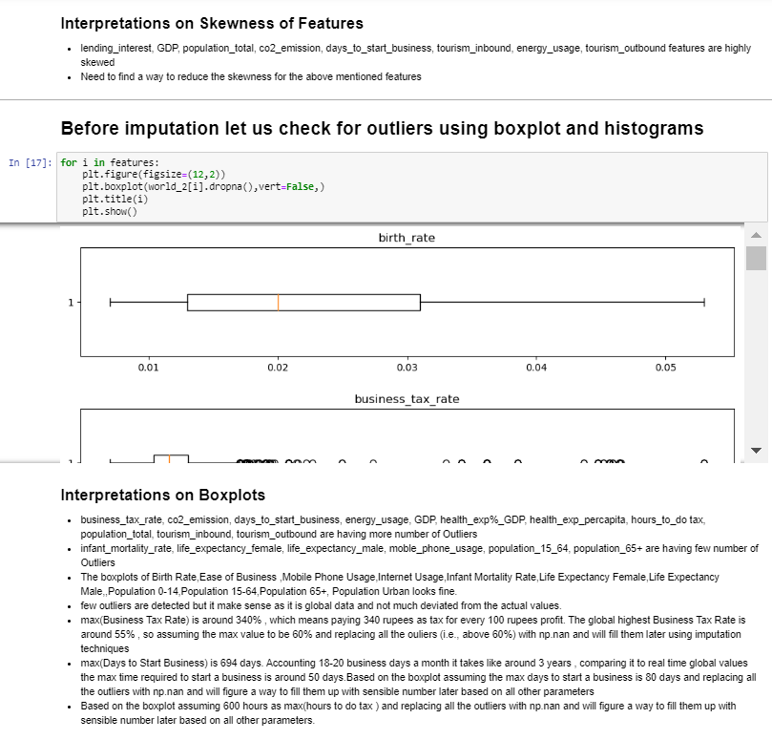
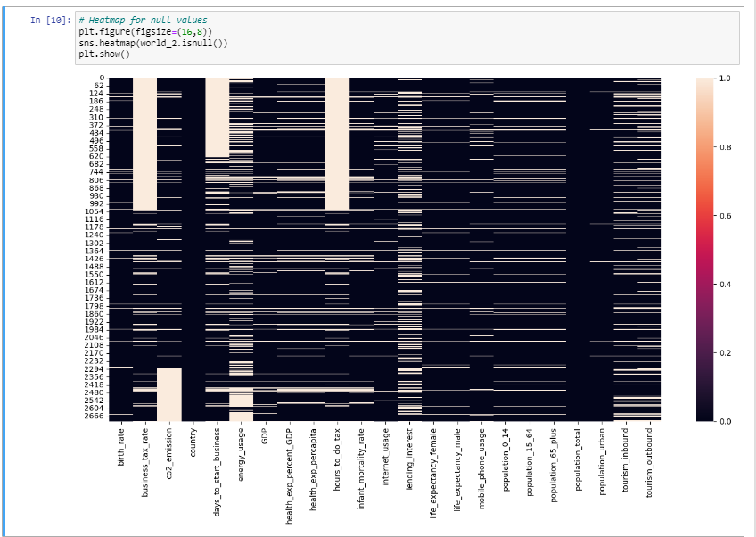
Slide 4
Exploration of Data
%
t amet.
73%
4
Notes:
EDA is a step to ensure the data is cleaned and ready for processing, providing insights and preventing errors.
co2_emission, energy_usage, GDP, health_exp_percapita, population_total, tourism_inbound, tourism_outbound mean values are far away from the 50% of the data.
Remaining features are somewhat nearby the 50% of data.

Slide 6
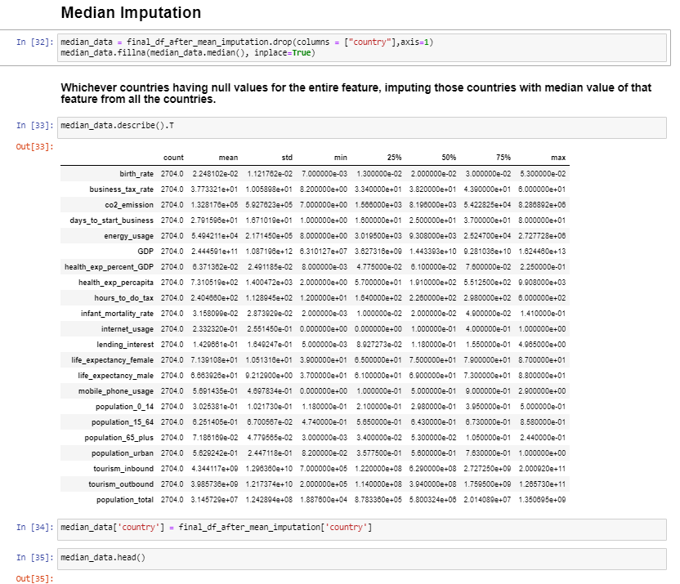
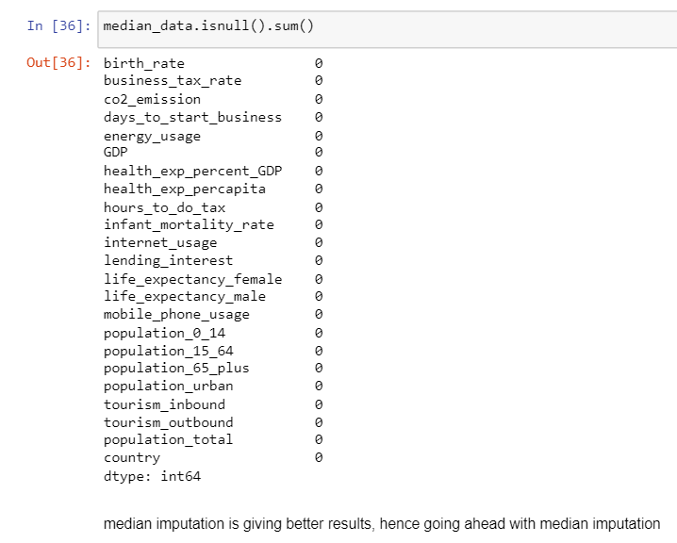
Feature Engineering
Notes:
The quality and relevance of the features significantly impact the performance of machine learning algorithms. Feature engineering can have a more substantial effect on the model's performance than the choice of the model itself. Good feature engineering can make even simple models perform remarkably well.

Slide 7
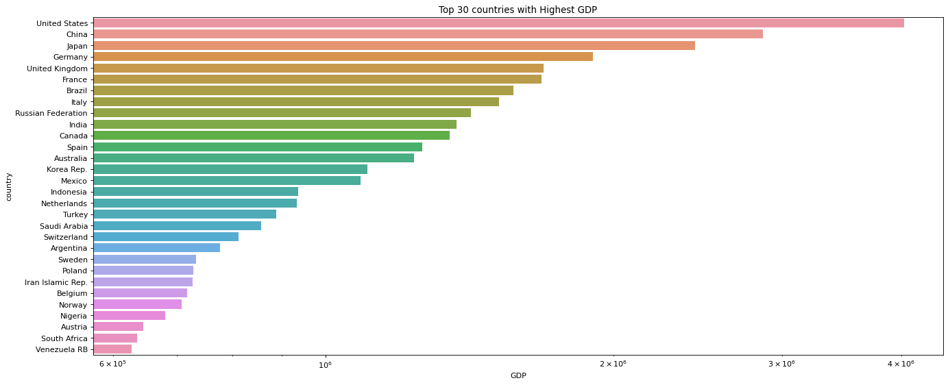
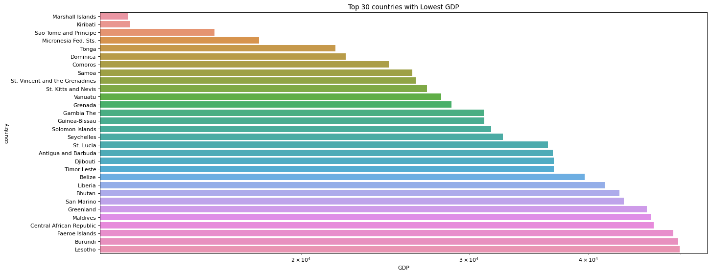

Slide 8
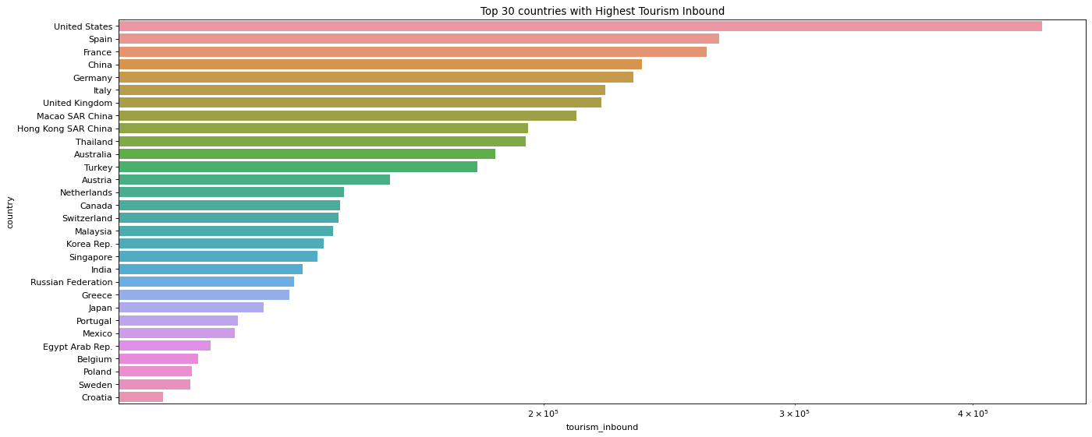
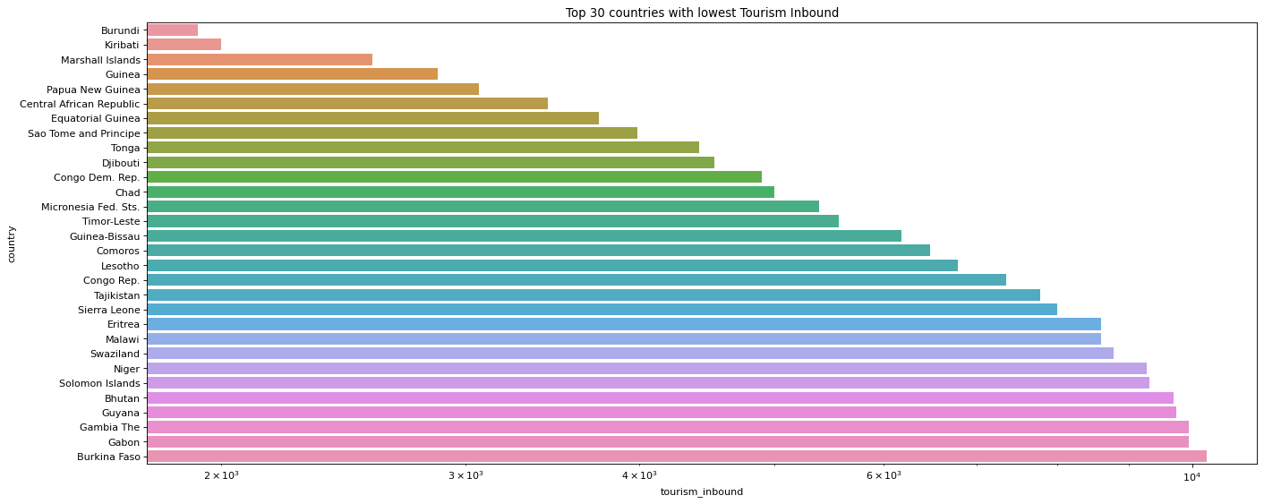

Slide 9
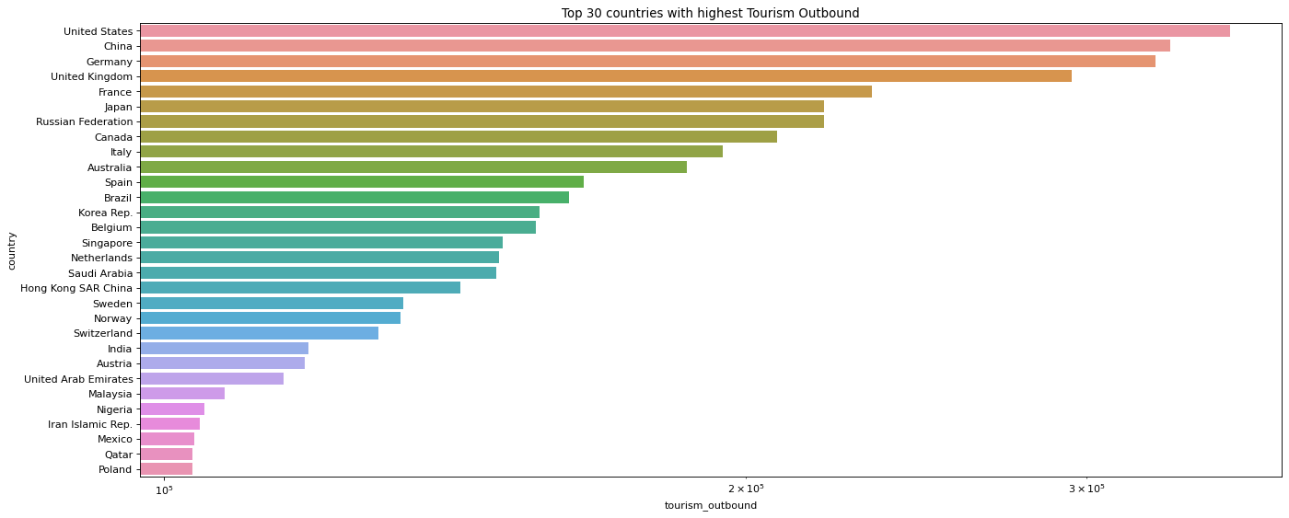
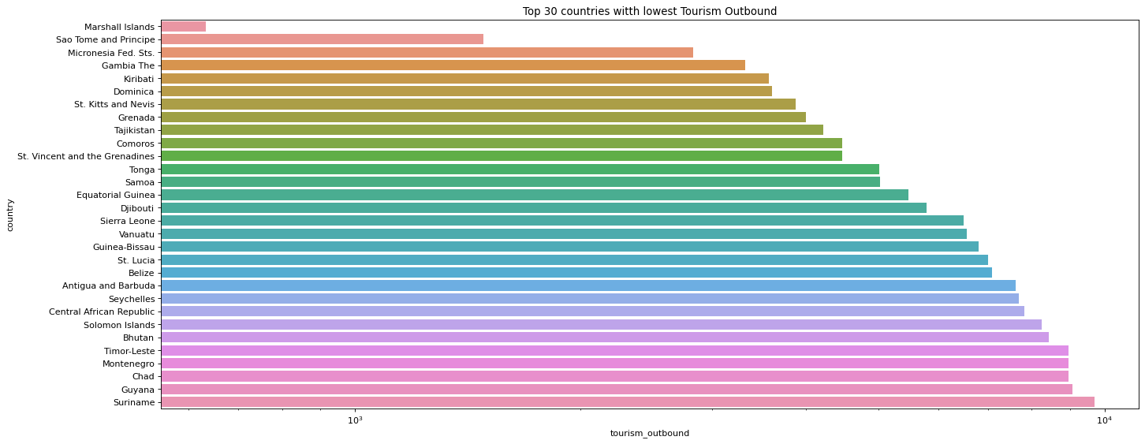

Slide 10
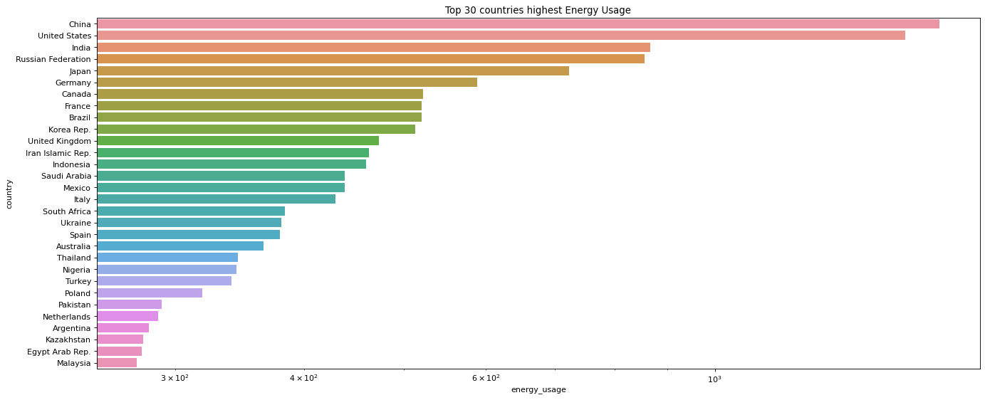
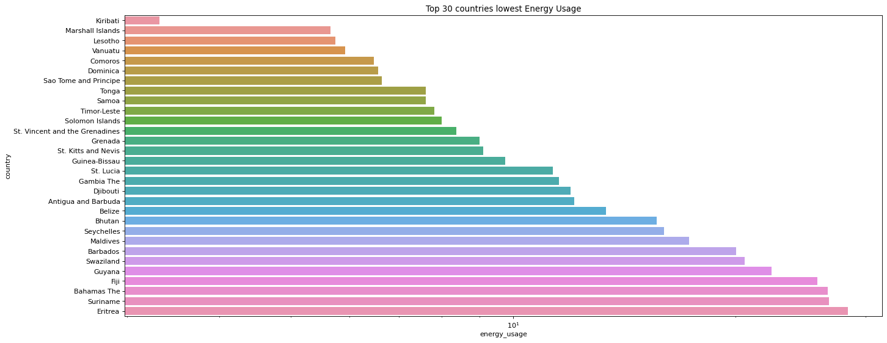

Slide 11
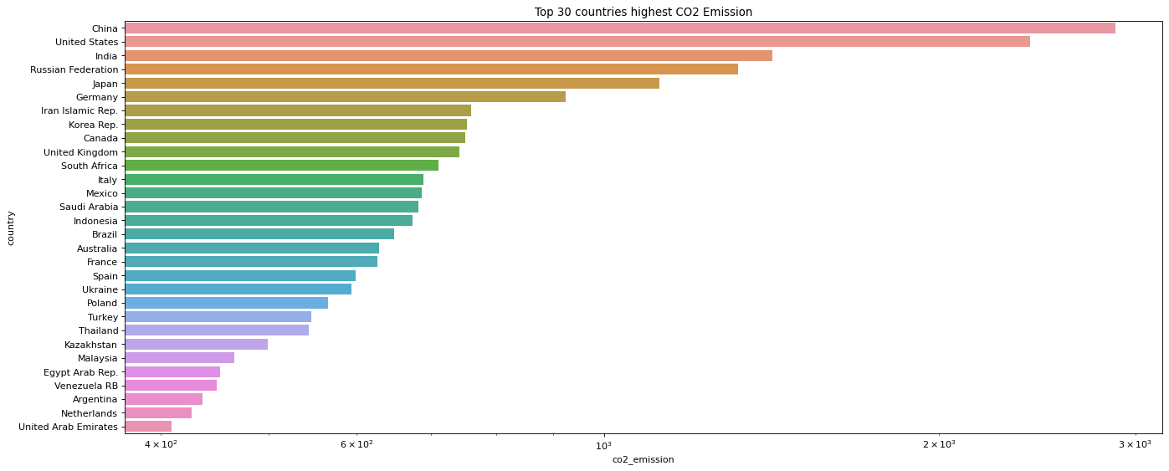
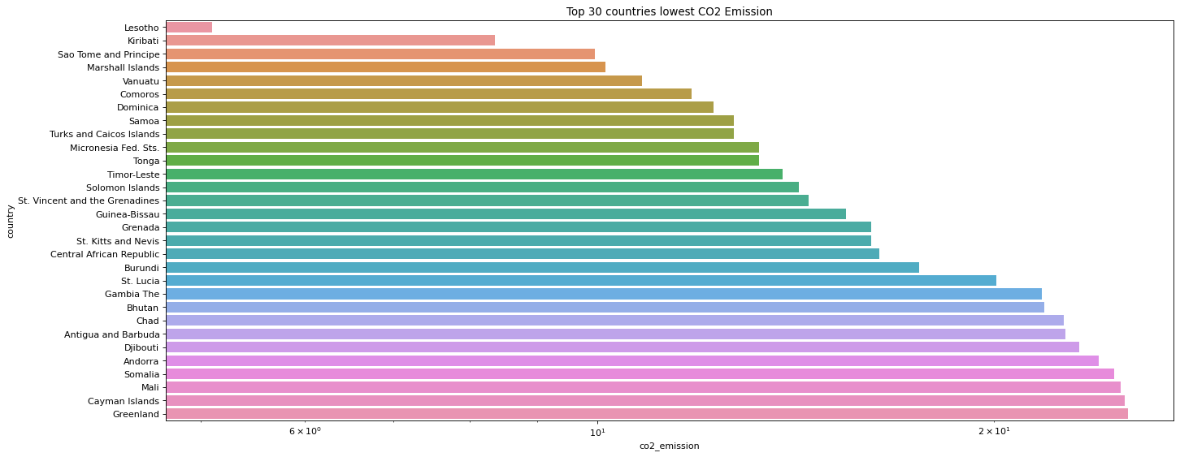

Slide 12
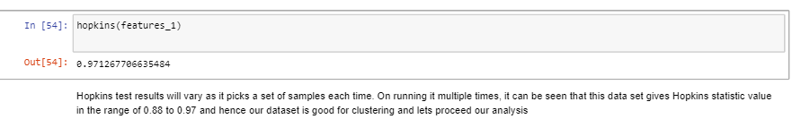
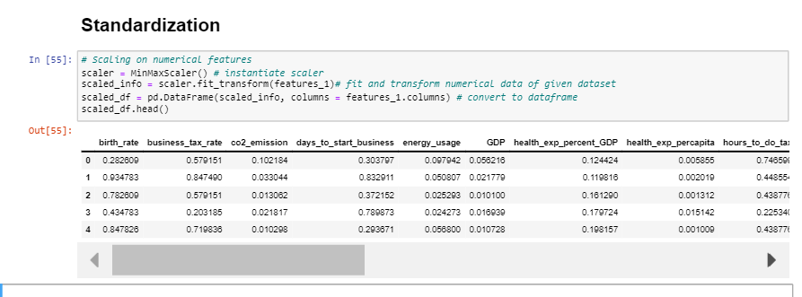

Slide 13
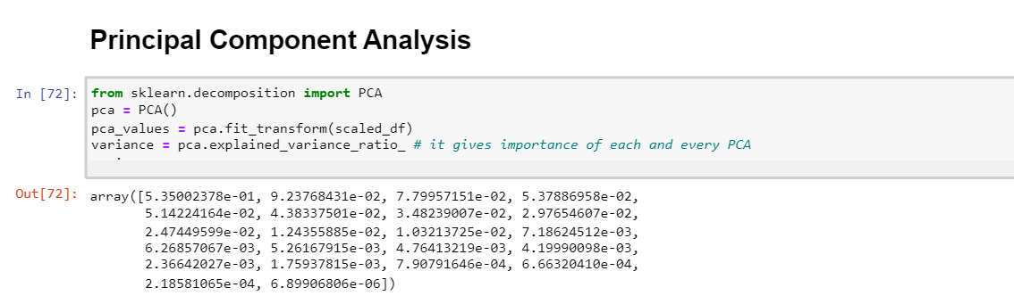
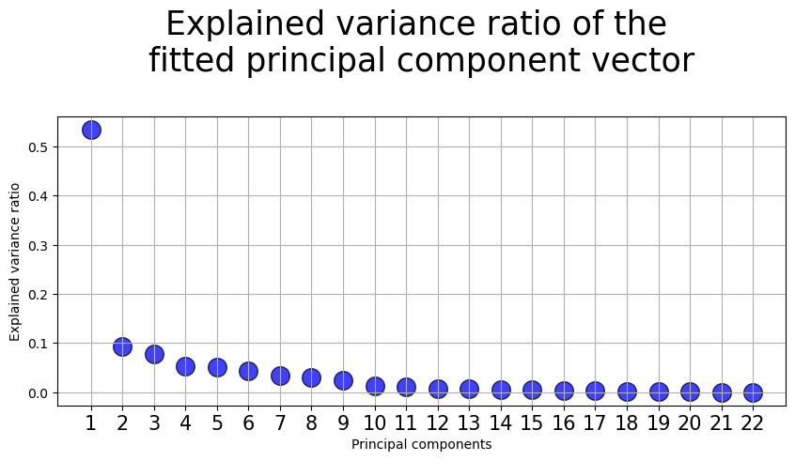
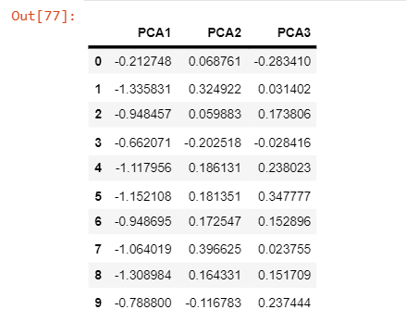
PCA

Slide 14
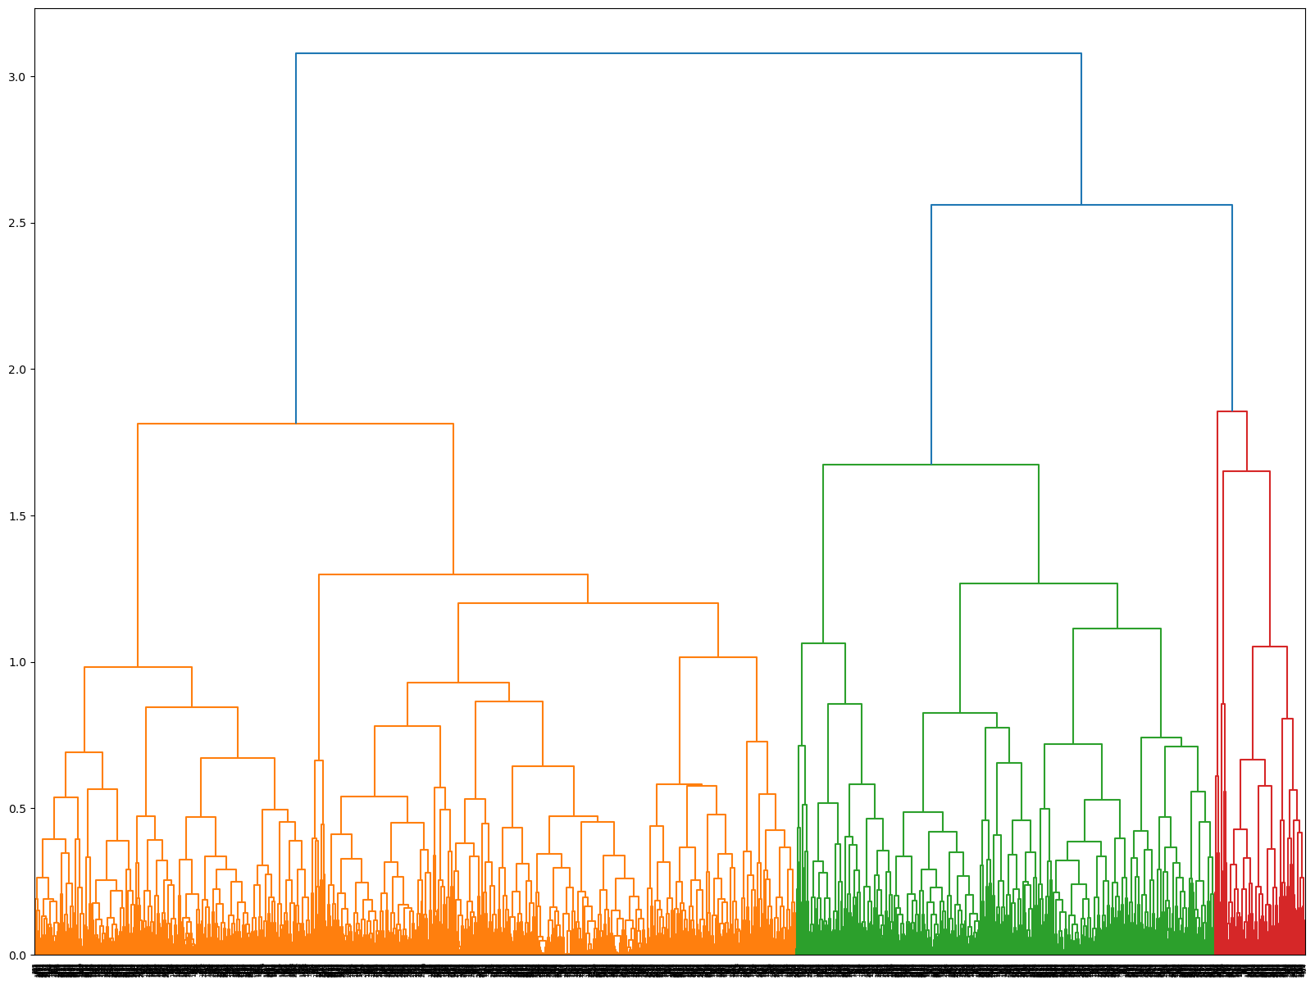
Agglomerative or Hierarchical Clustering using PCA values

Slide 15
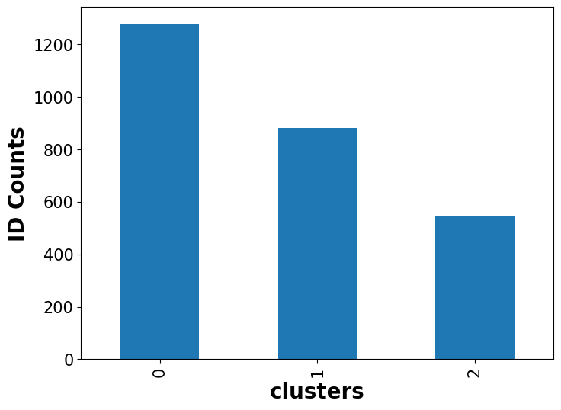
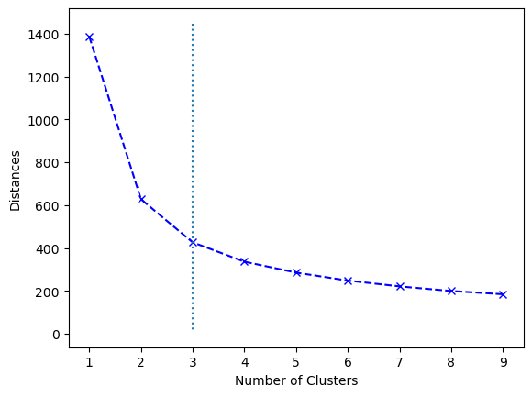
By Elbow Method we get 3 Optimal clusters.
No. of Optimal Cluster is 3
Notes:
If the elbow point is at "3" on the x-axis, it suggests that three clusters are an appropriate choice for the given dataset. Beyond this point, adding more clusters does not provide a significant improvement in clustering quality and may lead to overfitting or excessive granularity.

Slide 16
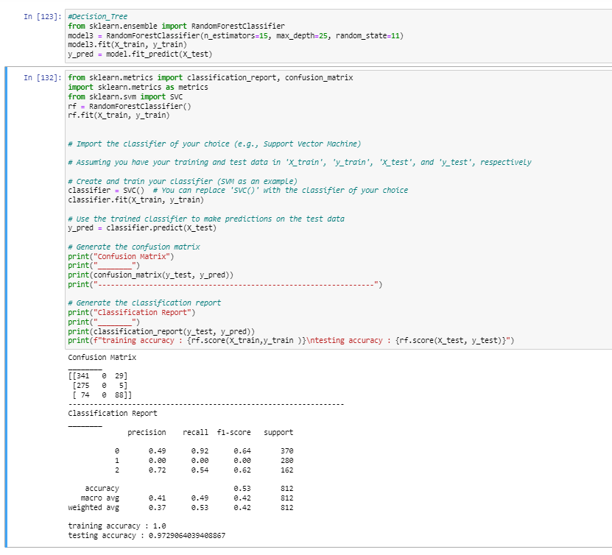
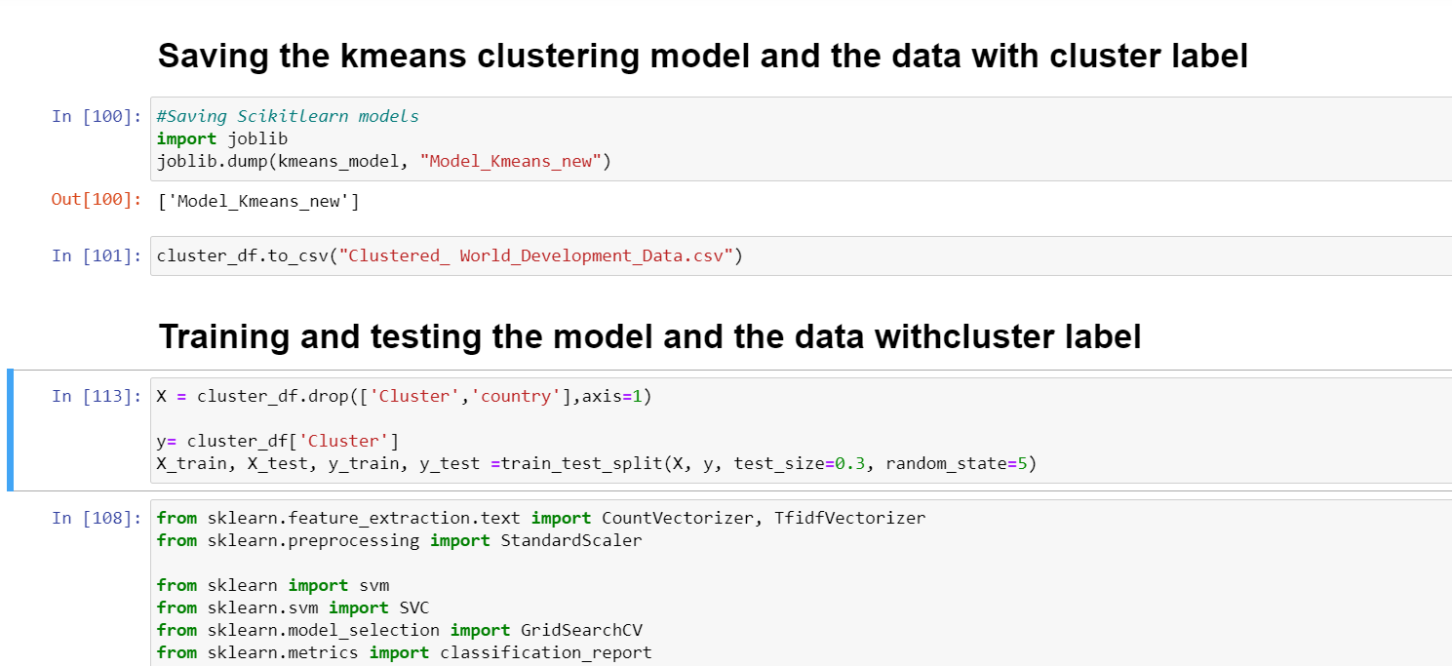
Model Building
Now, This is our Final model

Slide 17
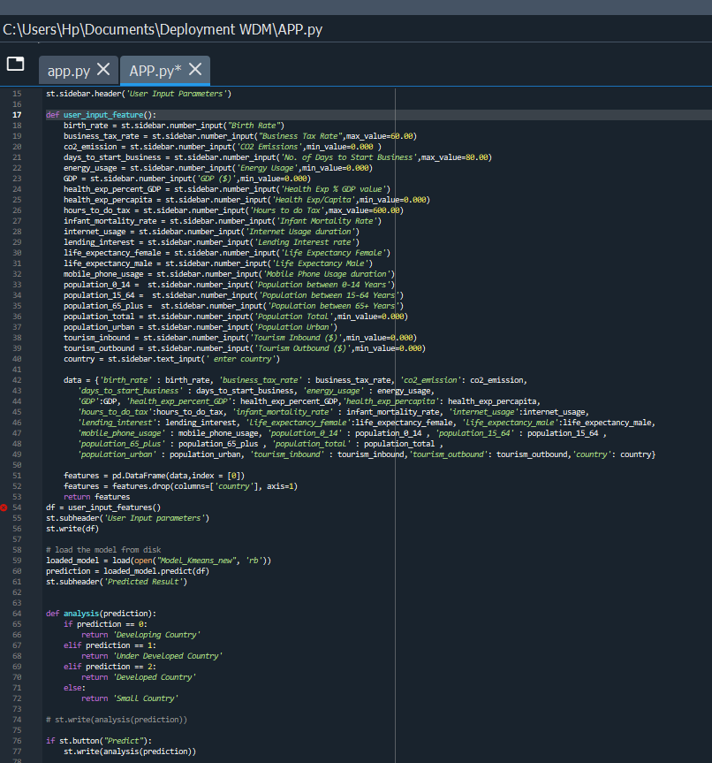
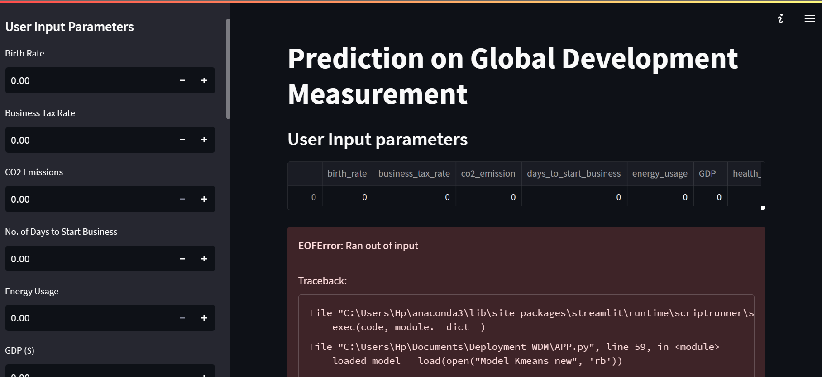
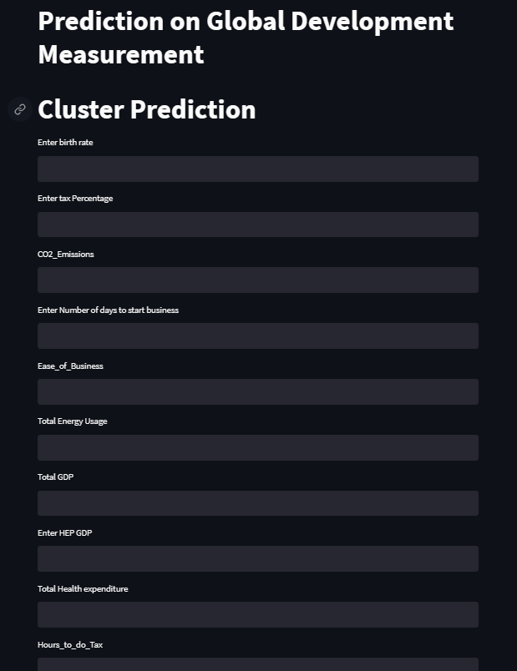
Model Deployment
1. The final model deployment aims to utilize the World Development Measurement data to predict and gain insights into key socio-economic indicators.
2. Continuous monitoring and updates will be implemented to ensure the model's effectiveness in capturing evolving trends and patterns.

Slide 18

Slide 11
THANK YOU

